Slide 1
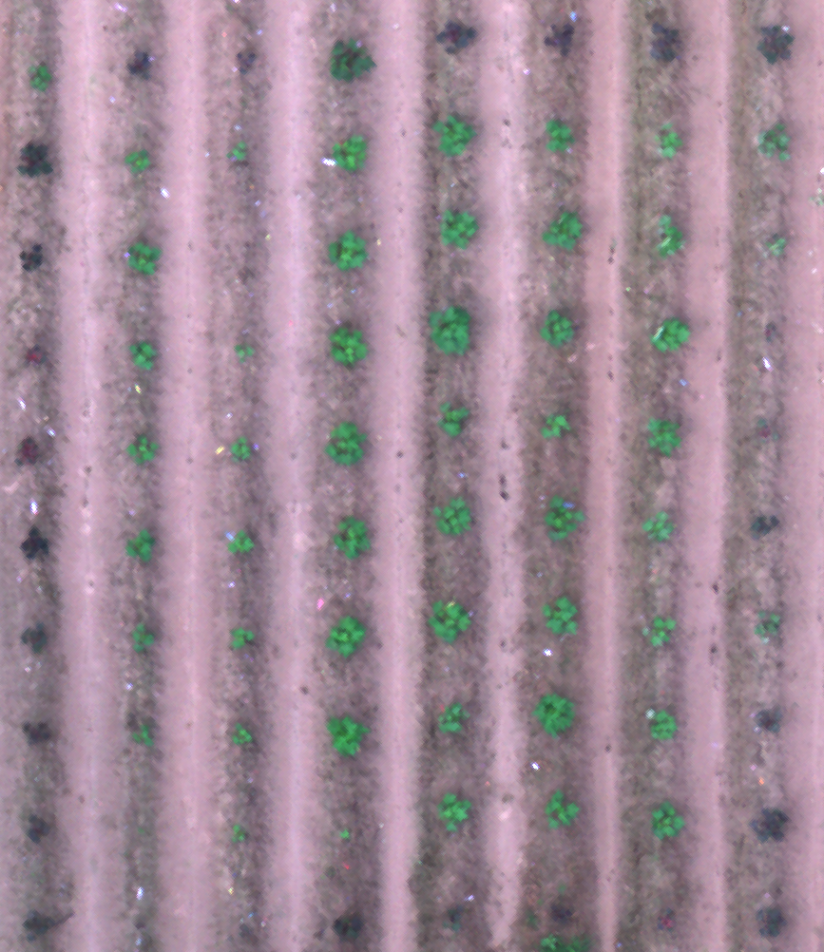
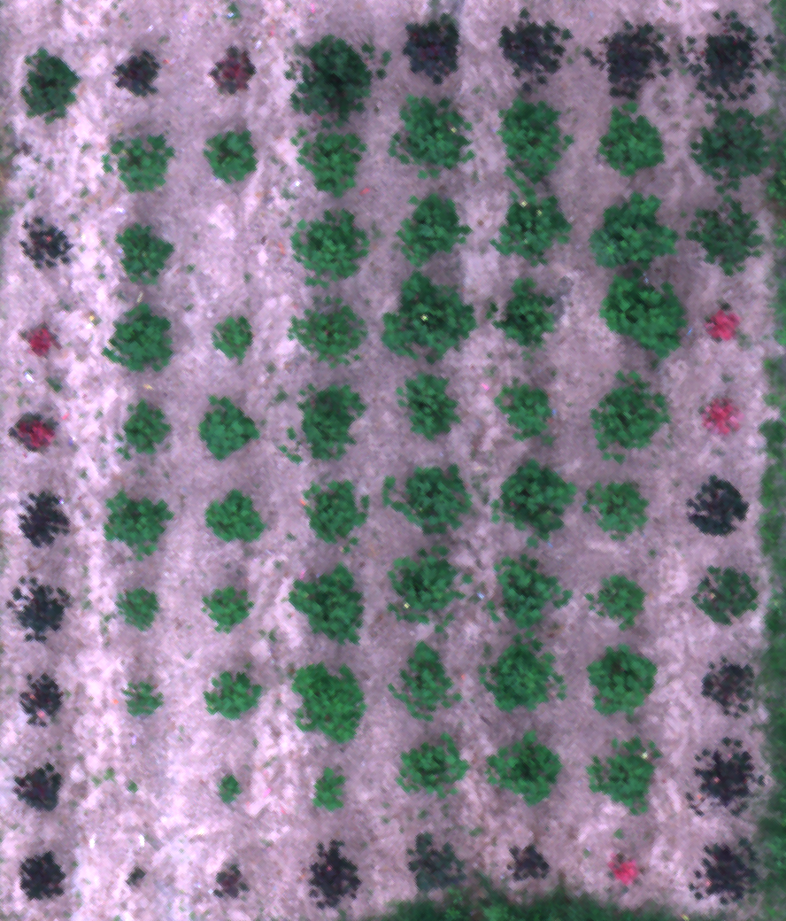
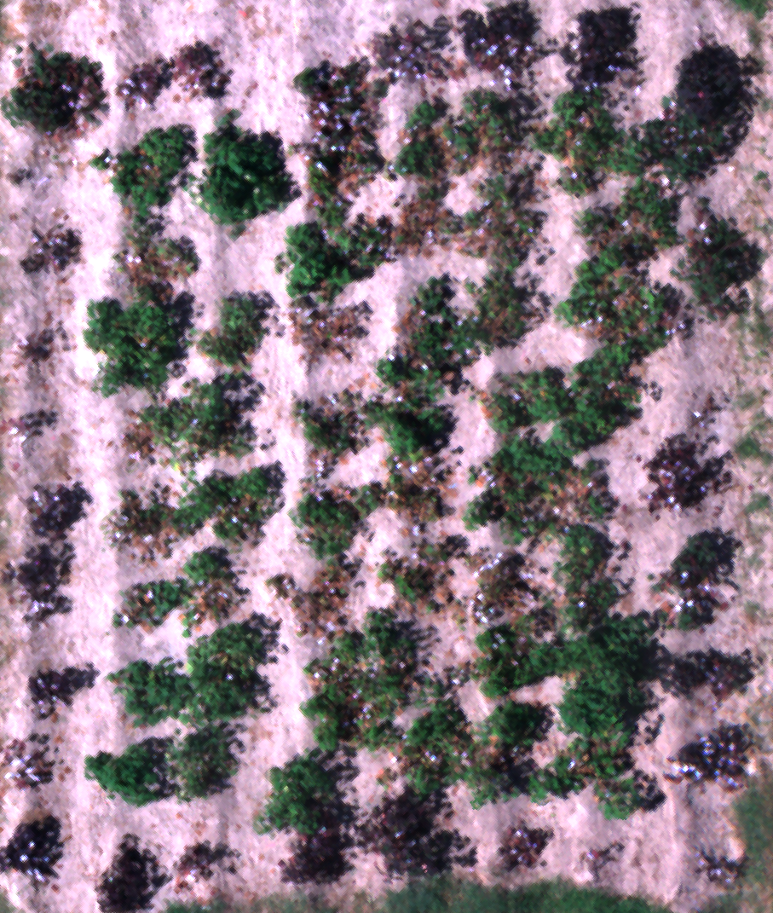
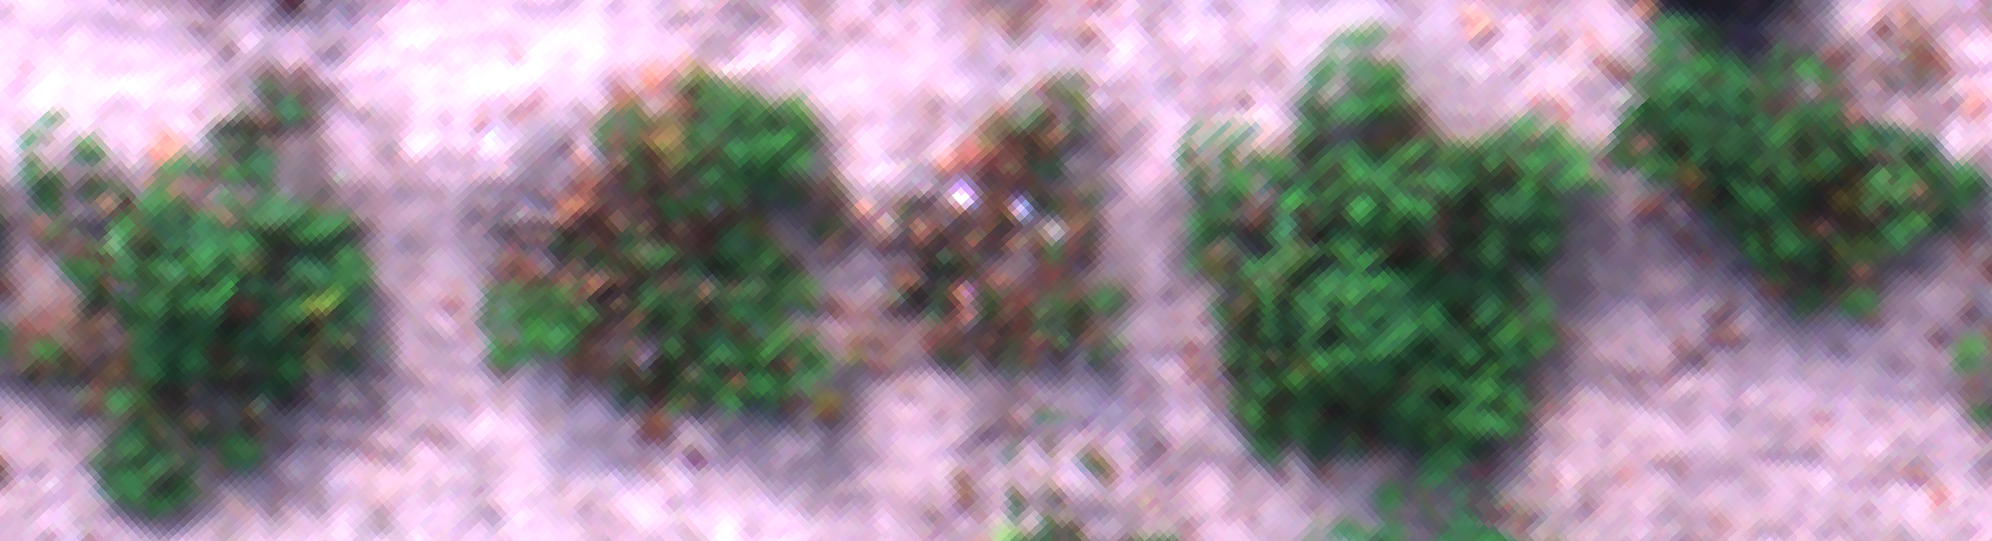
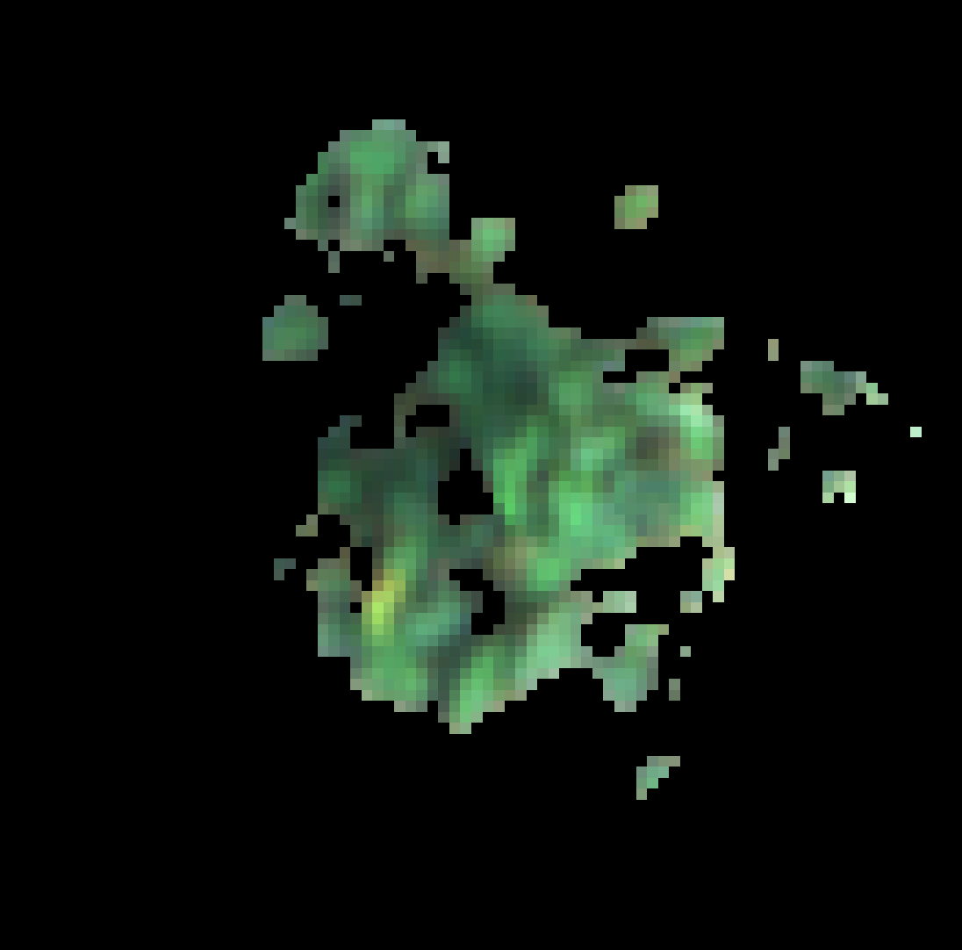
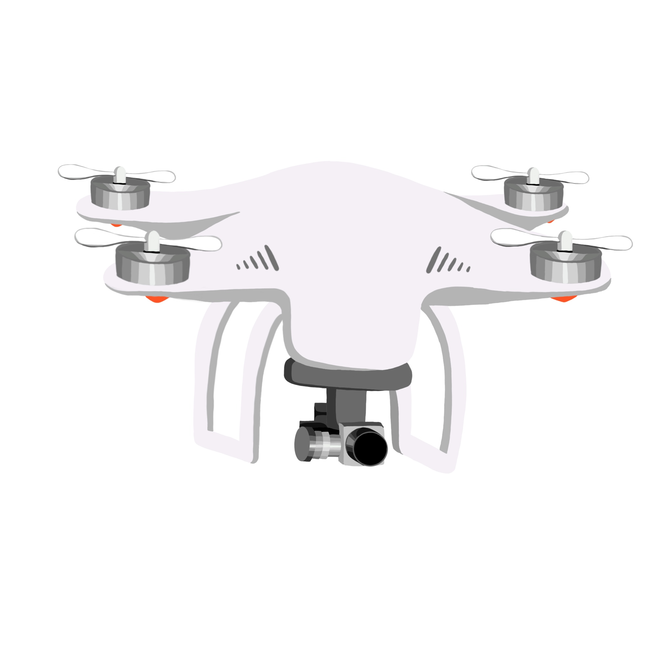
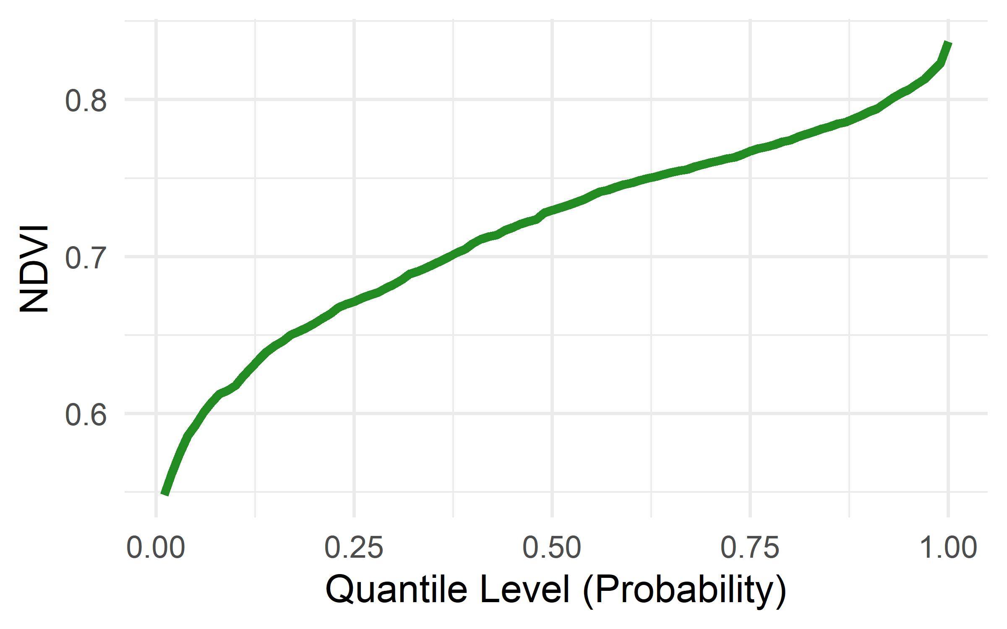
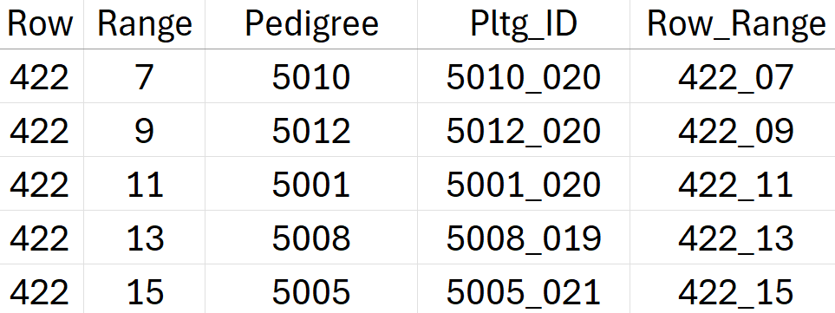
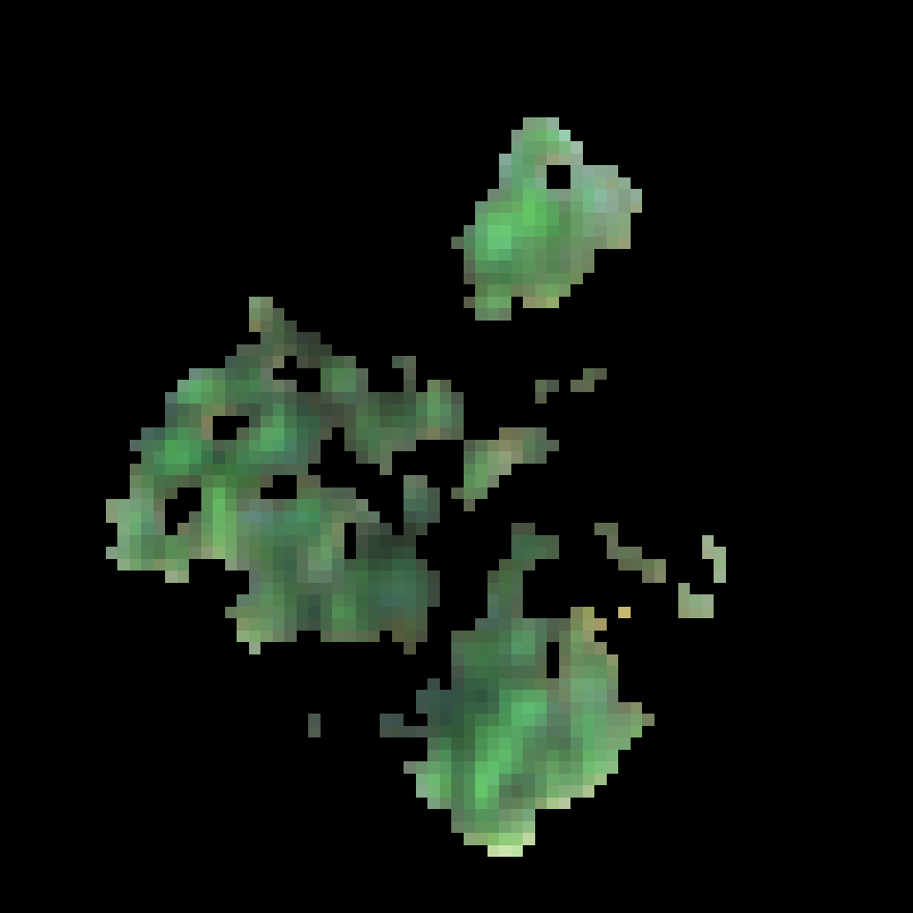
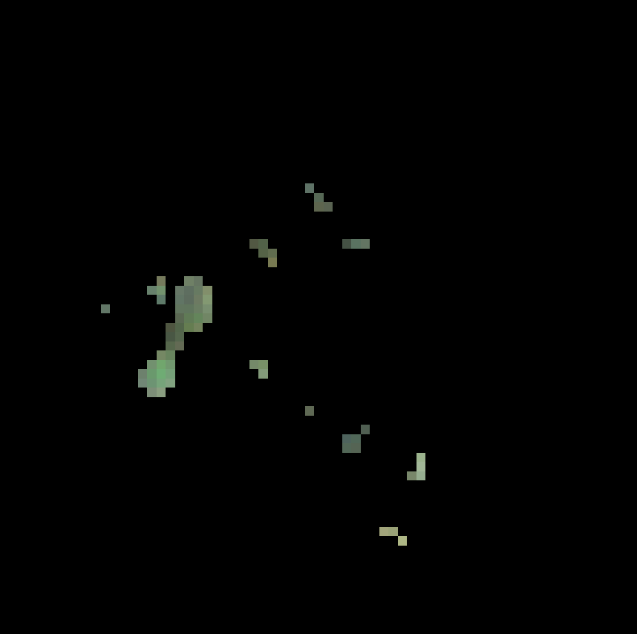
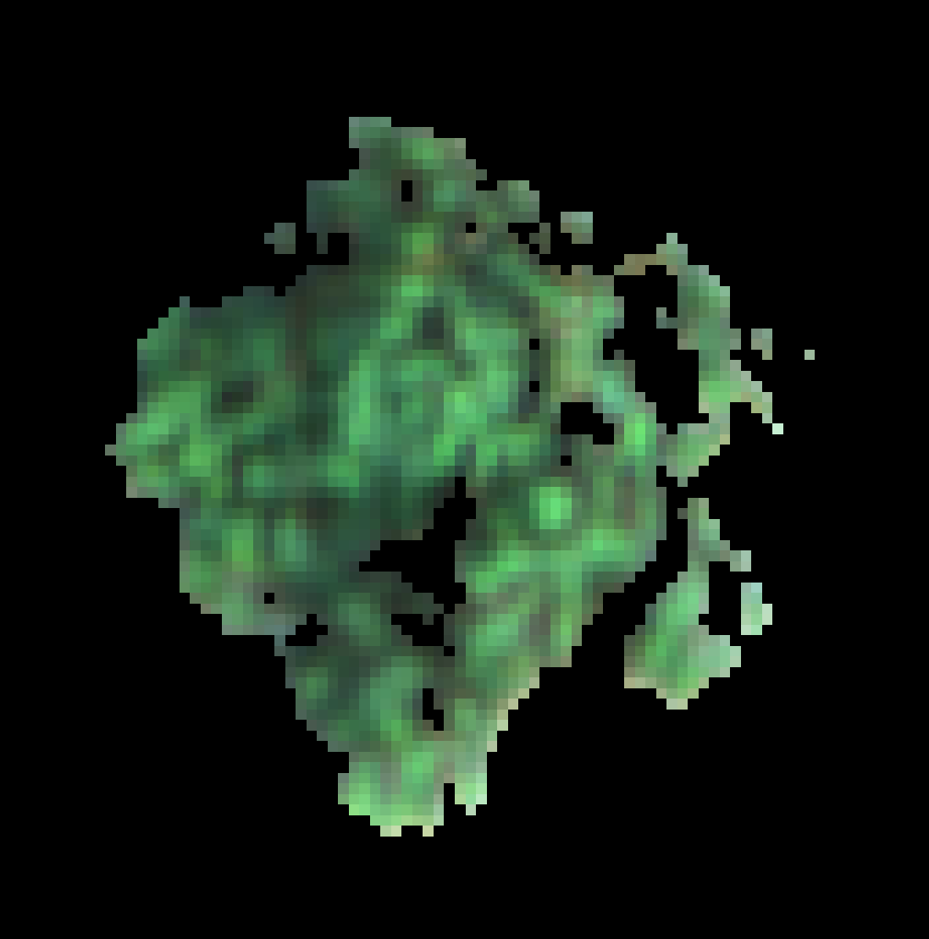
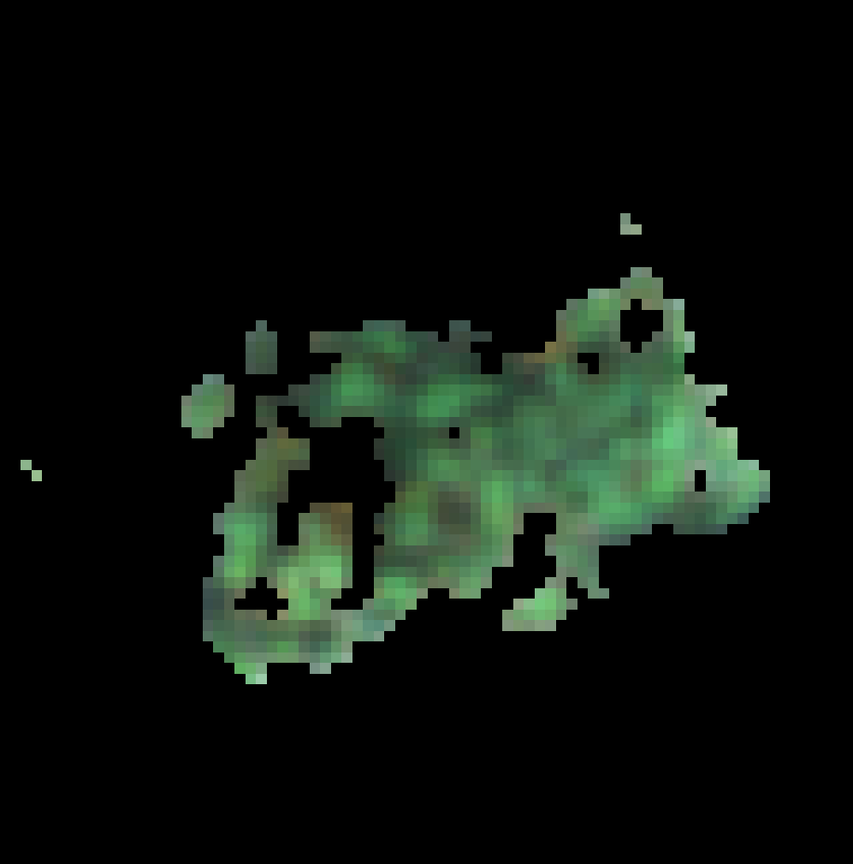
A – UAS flights and photogrammetry
C – Image extraction from orthomosaics
E – Extraction of Standard VIs and Distributional Data
crop_regions_from_ortho()
compute_multi_vegetation_indices_parallel()
422_07
422_09
422_11
422_13
422_15
Daily multispectral flights from 17 May 2024 (transplanting) → 30 Aug. 2024 (senescence)
B – Shapefile creation from CSV file (works with plots or single plants)
D – Soil masking
process_and_save_masks_multi()
create_shapefile_from_csv()
422_09
422_11
422_13
422_15
422_07

